Slide 1
Snake game 2d – reinforcement learning
Agent-based systems 2022/2023
ACE GJORGJIEVSKi – 201183

Slide 2


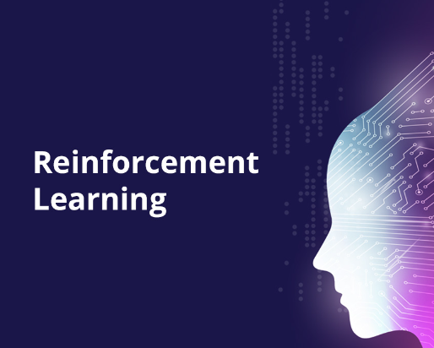

ARTIFICIAL INTELLIGENCE
Widely spread
Agent into action
Reinforcement Learning

Slide 3
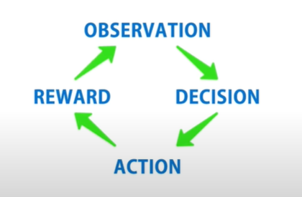
REINFORCEMENT LEARNING
Set of principles, algorithms and applications

Slide 4
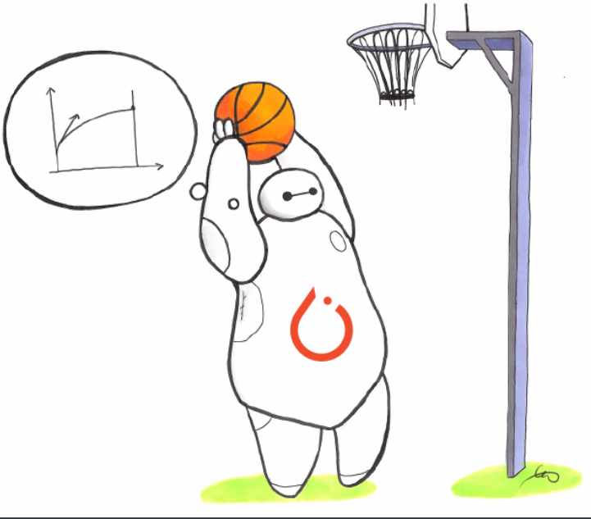


SNAKE GAME 2d – RL
Observation, decision, action and reward
Pygame, Gym, StableBaselines3

Slide 5
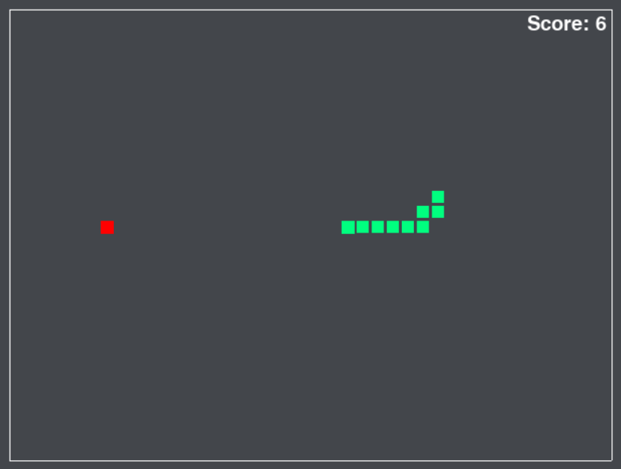
SNAKE GAME 2D – RL
Rewards and penalties
Death: -100
Eating an apple: +10
Distance: +1/ -1
Wasting time

Slide 6
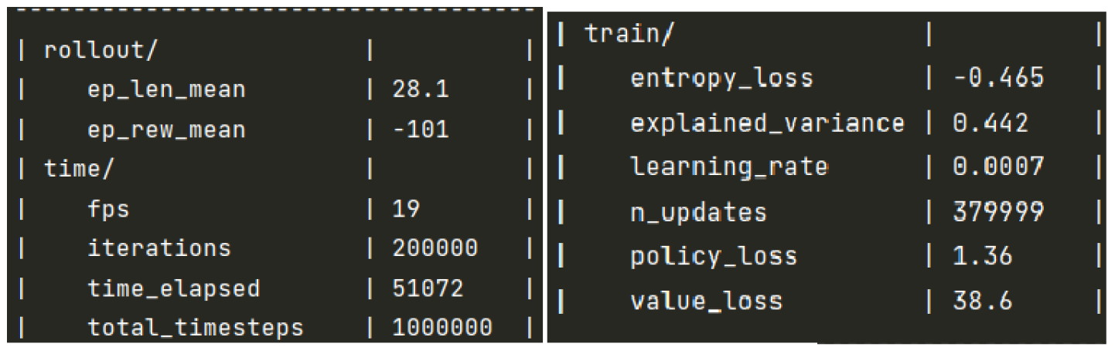
SNAKE GAME 2D – RL
Training algorithms
PPO (Proximal policy optimization)
A2C (Advantage Actor-Critic)

Slide 7
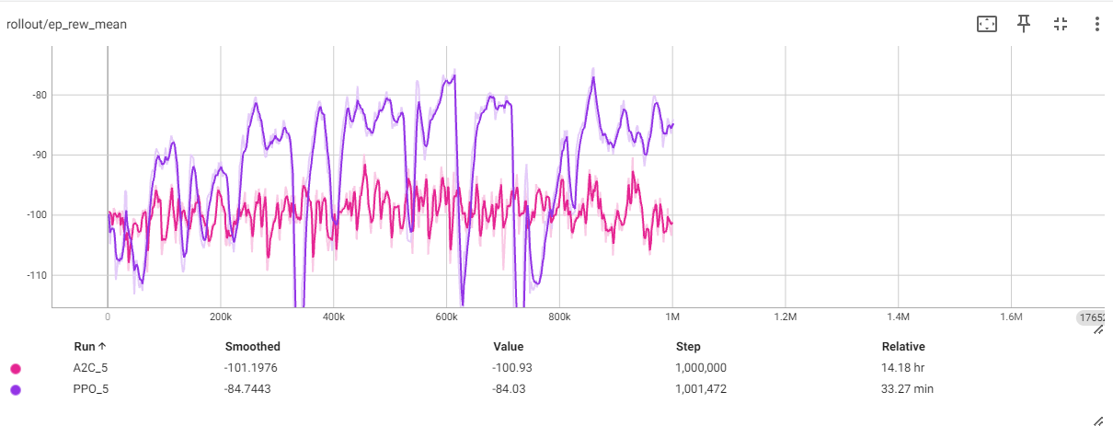
SNAKE GAME 2D – RL
Visual representation on TensorBoard

Slide 8
CONCLUSION
Exhausting and fun ☺
Enough to dive into the real realm of knowledge
Watching how machines play video games

Slide 9
QUESTIONS?

Slide 10



THANK YOU !

